Slide 1
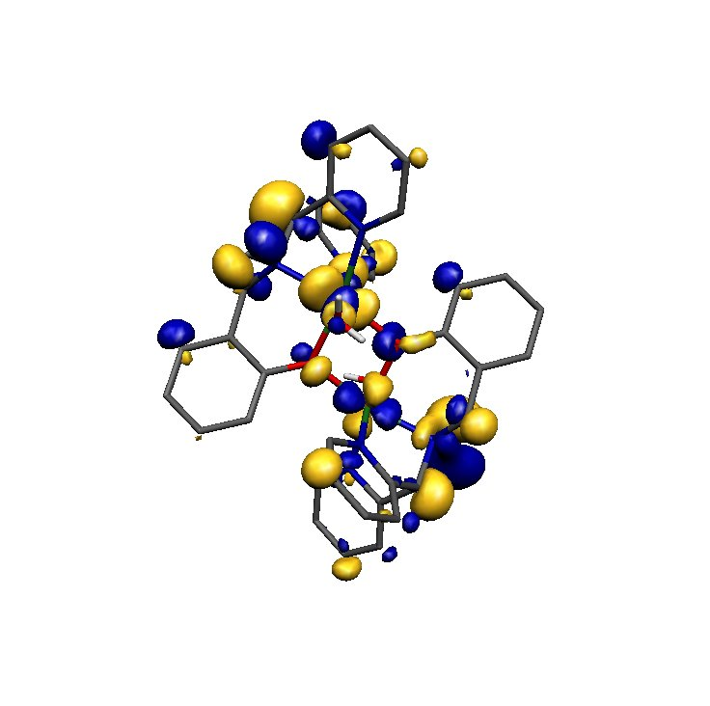
Molecular Orbital Theory
or
when electrons don’t like sitting between atoms!

Slide 2
Molecular Orbital Theory
In the molecular orbital model, orbitals on individual atoms interact to produce new orbitals, called molecular orbitals, which are now identified with the whole molecule.
THROW OUT THE IDEA OF LOCALIZED BONDING

Slide 3
Why Do Atoms Form Molecules?
The Aufbau principle tells us to put electrons into the lowest energy configuration in atoms. Similarly, molecules form when the total energy of the electrons is lower in the molecule than in individual atoms.
Just as we did with quantum theory for electron in atoms, we will use the molecular quantum theory to obtain.
1. Molecular Orbitals What are the shapes of the waves?
Where are the lobes and nodes?
What is the electron density distribution?
2. Allowed Energies. How do the allowed energies change when bonds form?
We will use the results of these calculations to make some simple models of bond formation, and relate these to pre-quantum descriptions of bonding.
These will build a “toolkit” for describing bonds, compounds and materials.

Slide 4
Wavefunctions and Energies: Bonding in H₂
If we calculate the wavefunctions and allowed energies of a two proton, two electron system as a function of separation between the nuclei (the bond length), then we see how two atoms are transformed into a molecule.
This calculation tells us:
  Whether a bond forms - Is the energy of the molecule lower than the two atoms?
  The equilibrium bond length - What distance between the nuclei corresponds to the minimum in the energy?
  The structure of the bond - What is the electron density (charge) distribution (ψ ²)?
  Electronic properties of the molecules - Bond strength, spectroscopic transitions (colour…), dipole moment, polarizability, magnetic character...

Slide 5
Diatomic Molecular Orbital Theory
In the case of diatomic molecules, the interactions are easy to see and may be thought of as arising from the constructive interference of the electron waves (orbitals) on two different atoms, producing a bonding molecular orbital, and the destructive interference of the electron waves, producing an antibonding molecular orbital
This Approach is called LCAO-MO
(Linear Combination of Atomic Orbitals to Produce Molecular Orbitals)
A Little Math is need to understand
Only a Little I promise!

Slide 6
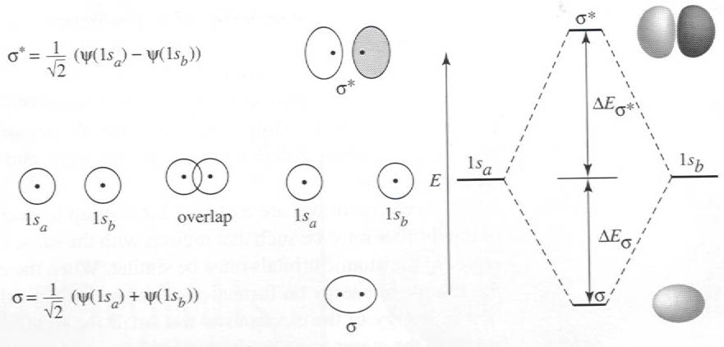
How to impress your friends and family!
Making Molecular Orbitals
Antibonding
Bonding
In this case, the energies of the A.O.’s are identical

Slide 7
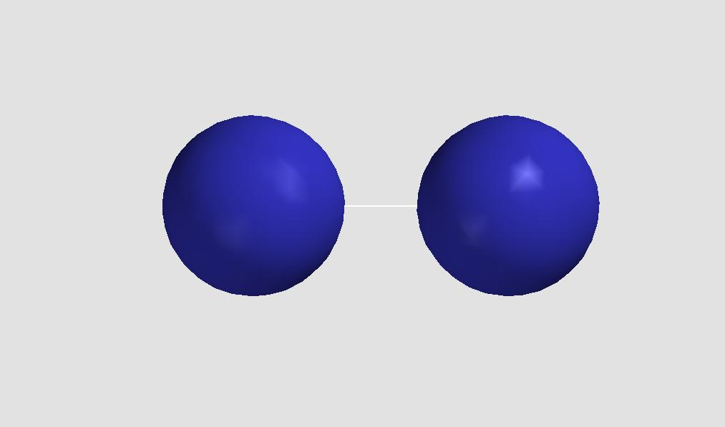
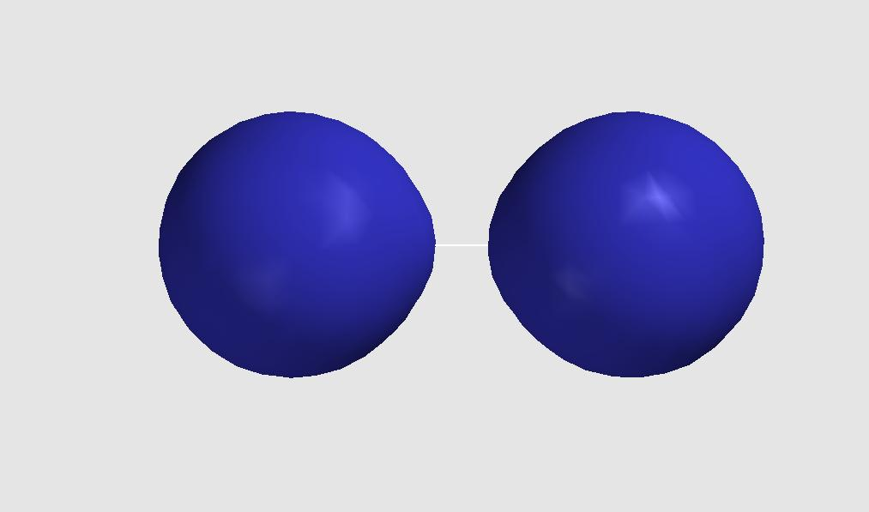
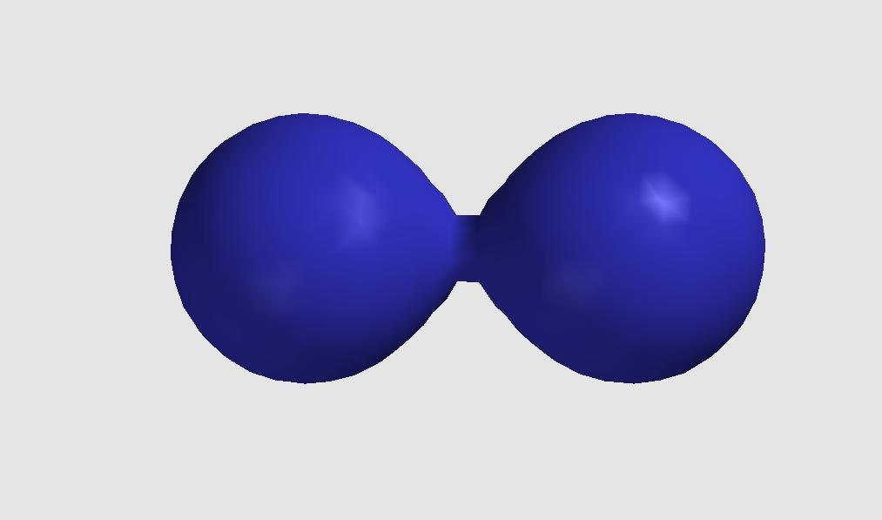
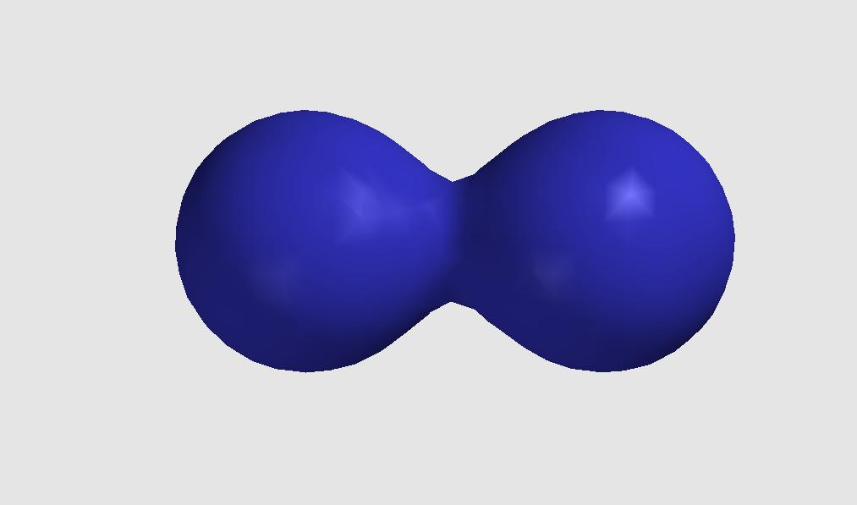
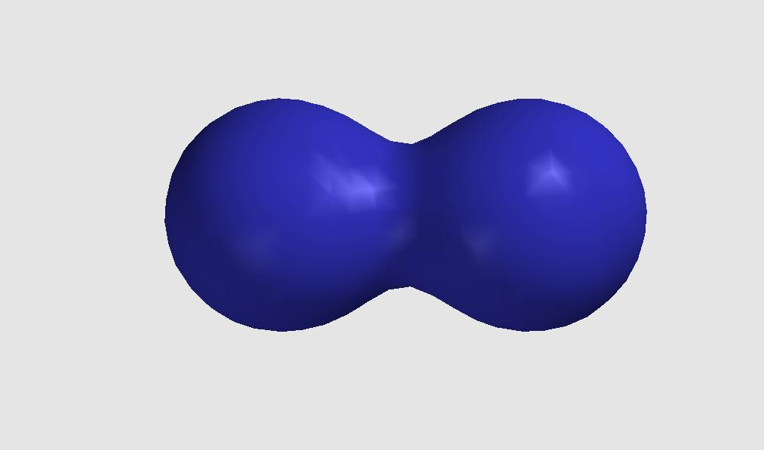
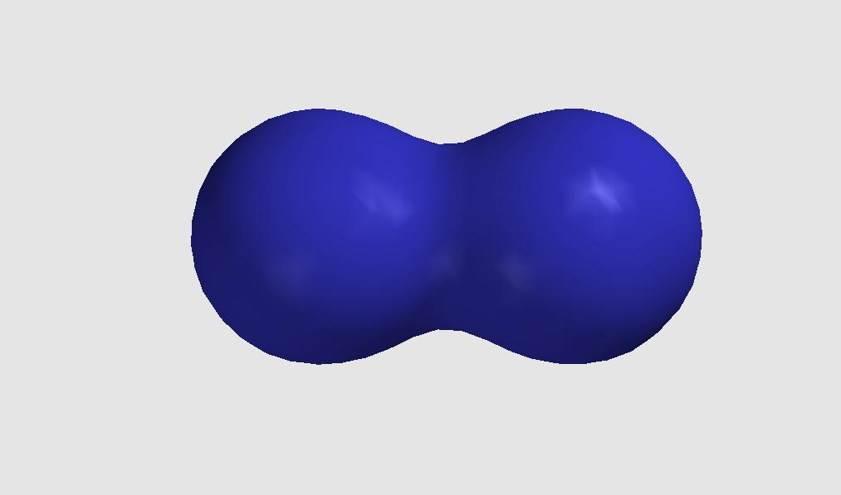
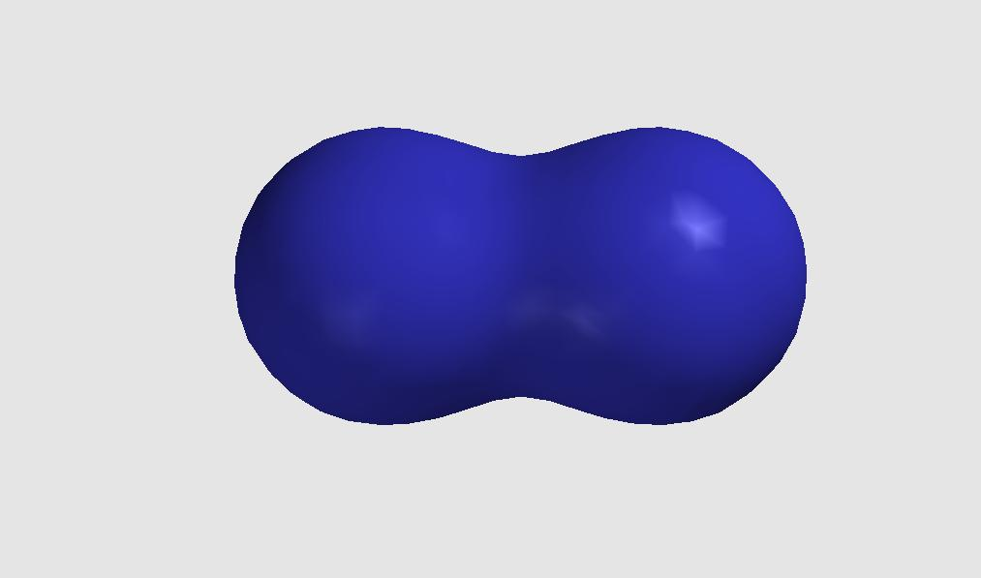
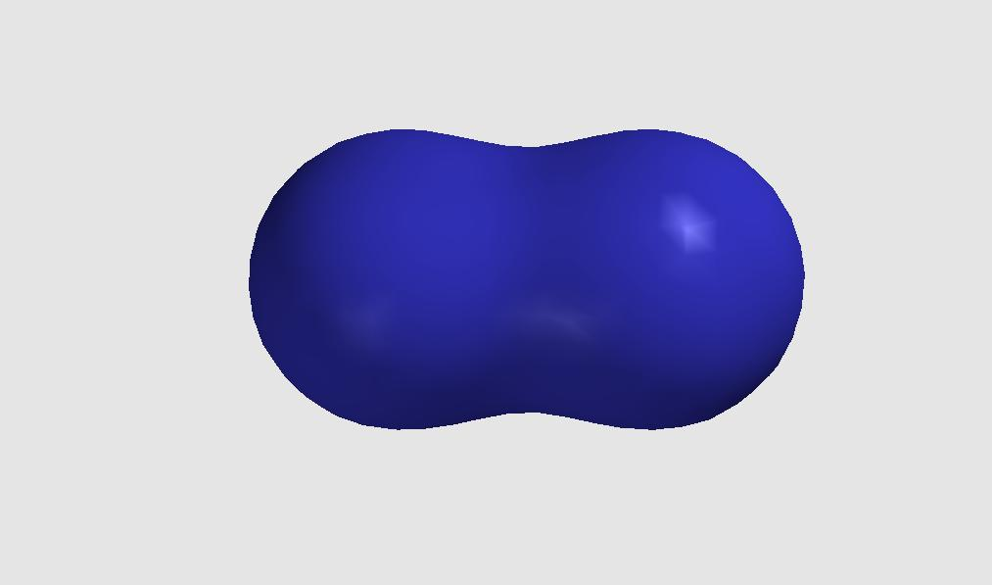
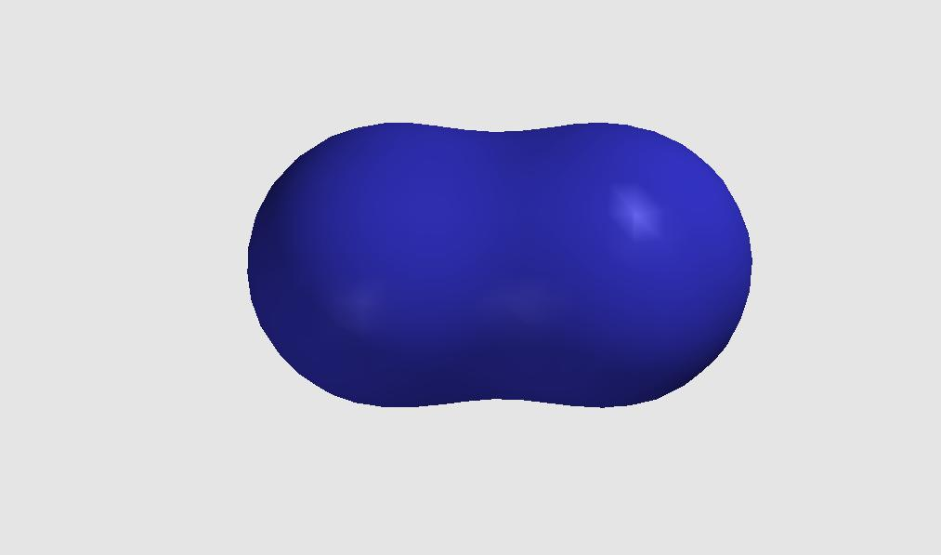
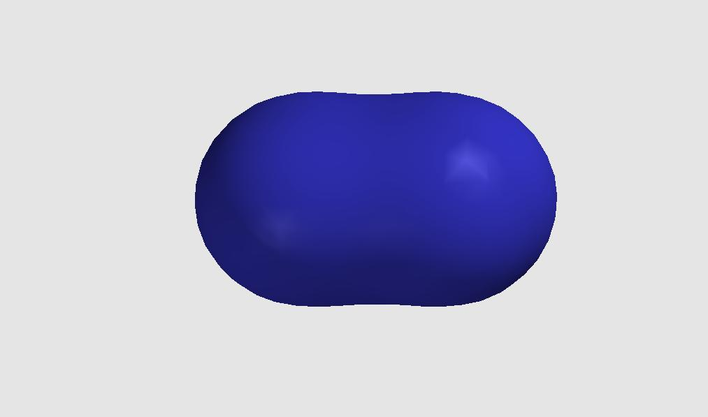
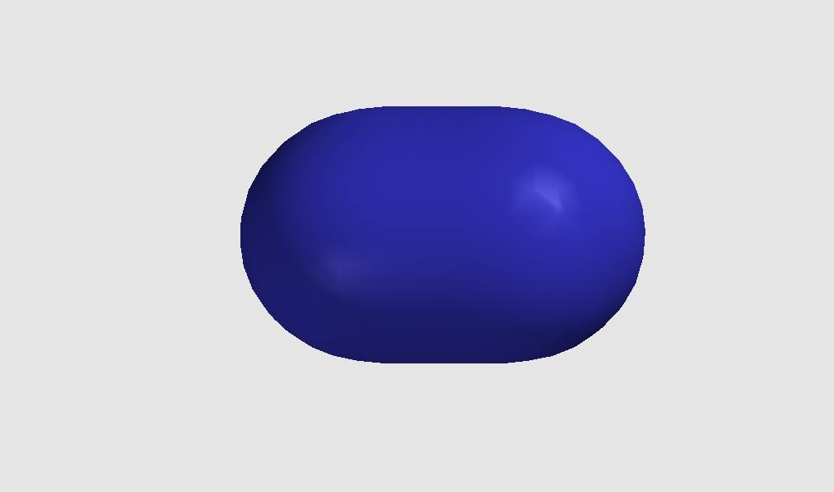
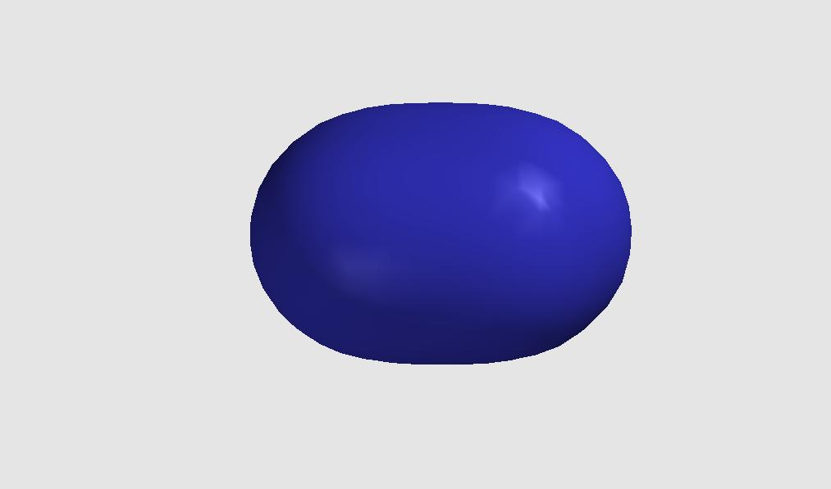
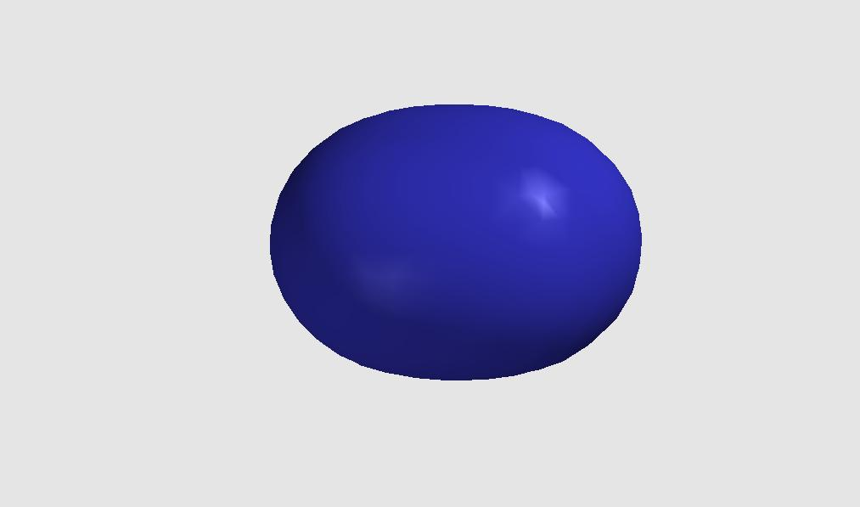
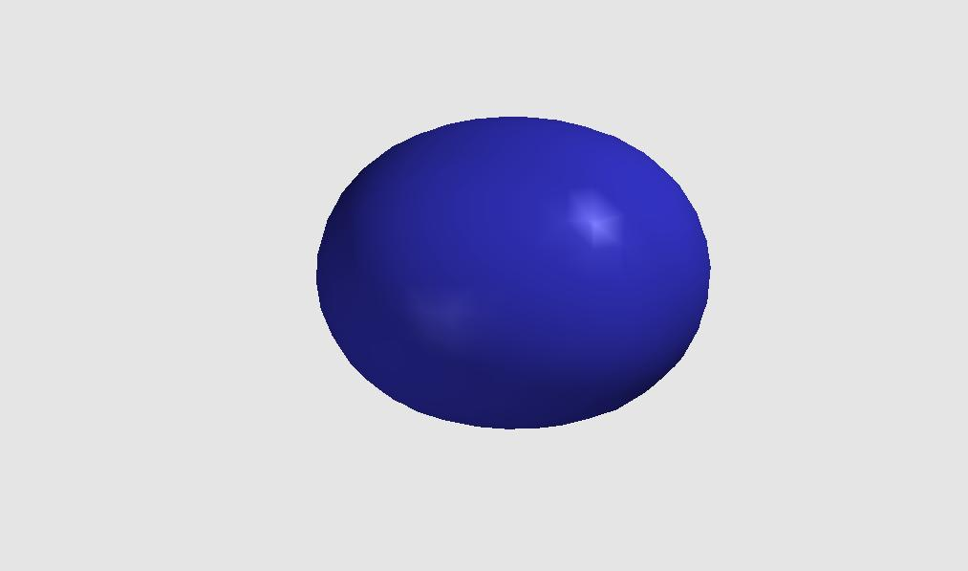
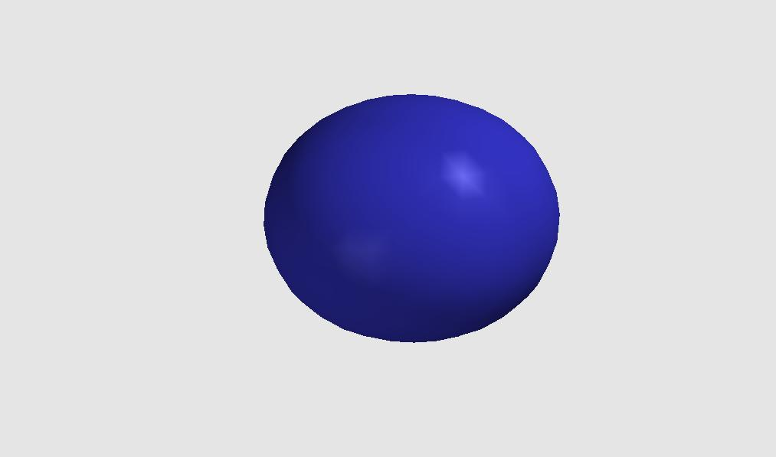
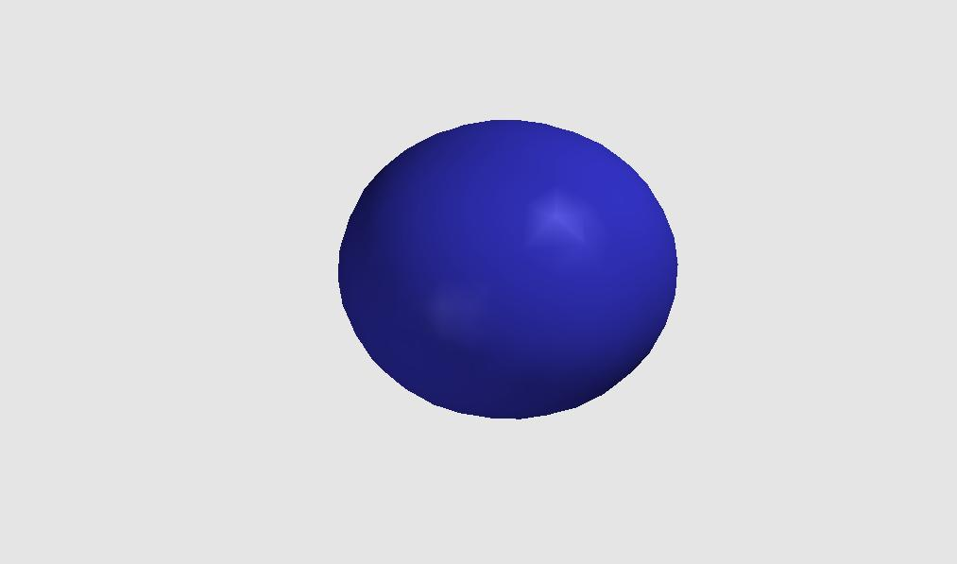

Molecular Orbital of H₂
The lowest energy state of two isolated hydrogen atoms is two 1s orbitals each with one electron. As the nuclei approach each other, the lowest energy state becomes a molecular orbital containing two paired electrons.
This lobe represents the orbital or wavefunction of the electrons delocalized around the two protons. This is a bond.

Slide 8
Quantum States in H₂ (as computed)
H₂ also has other electronic quantum states with corresponding allowed energies. These molecular orbitals have lobe structures and nodes just like atomic orbitals.
0.735 Å
(H₂)
R = ∞
(H)
R = ∞
(H)
This diagram shows some allowed energy levels for atomic H and molecular H₂.
(R = ∞ denotes the two atoms at “infinite separation” - no bond.)
The orbitals are filled with electrons starting with the lowest energy, just like atoms.
2s
2s
1s
1s
↑↓

Slide 9
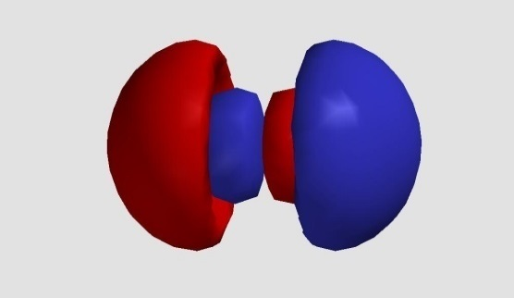
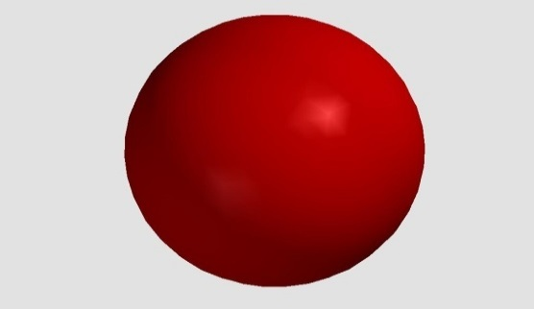
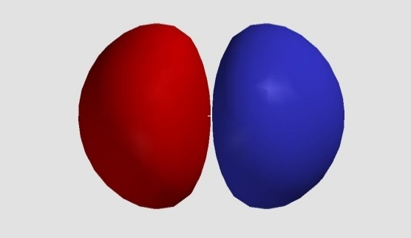
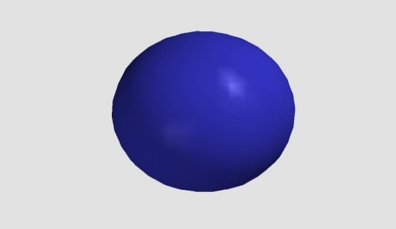
Quantum States in H₂ (as computed)
H₂ also has other electronic quantum states with corresponding allowed energies. These molecular orbitals have lobe structures and nodes just like atomic orbitals.
R = ∞
(H)
0.735 Å
(H₂)
2s
1s
↑↓

Slide 10
Quantum States in H₂: Allowed Energies
First let’s ignore the wavefunctions (orbitals), and consider only the allowed energies, just as we did with atoms. What do we observe?
R = ∞
(H)
0.735 Å
(H₂)
2s
1s
↑↓

Slide 11
Quantum States in H₂
The energy of the H₂ molecule is lower than the energy of two isolated H atoms. That is, the energy change of forming the bond is negative.
R = ∞
(H)
0.735 Å
(H₂)
We call this molecular orbital a bonding orbital for this very reason.
The other orbitals have higher energies than the atomic orbitals of H.
Electrons in these orbitals would not contribute to the stability of the molecule.
H₂ contains the simplest kind of bond, a pair
of electrons delocalized between two nuclei,
symmetric to rotation about the interatomic axis.
This is known as a sigma (σ) bond.
2s
1s
↑↓
σ

Slide 12
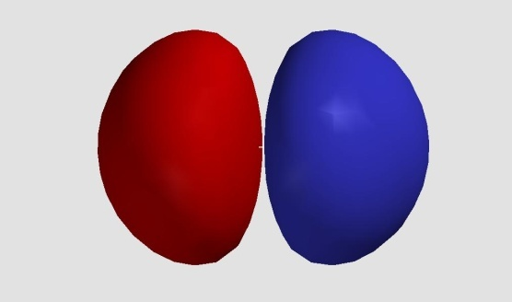

Molecular Orbitals in H₂
The next-lowest energy orbital is unoccupied. As it lies above the highest atomic orbital, we refer to it as an anti-bonding orbital.
R = ∞
(H)
0.735 Å
(H₂)
Look also at the shape of the lobes:
The anti-bonding orbital has a node between the two nuclei.
Where the bonding orbital has an electron density build-up between the nuclei, the anti-bonding orbital would have a reduced
electron density (ψ ²).
2s
This orbital is called the Lowest Unoccupied Molecular Orbital (LUMO)
σ∗
1s
↑↓
This orbital is called the Highest Occupied Molecular Orbital (HOMO)
σ

Slide 13

Molecular Orbital Theory
The solution to the Wave Equation for molecules leads to quantum states with discrete energy levels and well-defined shapes of electron waves (molecular orbitals), just like atoms.
Each orbital contains a maximum of two (spin-paired) electrons, just like atoms.
Bonds form because the energy of the electrons is lower in the molecules than it is in isolated atoms. Stability is conferred by electron delocalization in the molecule as they are bound by more than one nucleus (longer de Broglie wavelength).
This gives us a convenient picture of a bond as a pair of shared (delocalized) electrons. It also suggests some simple (and commonly-used) ways of
representing simple σ bonds as:
1. A shared pair of electrons (dots)
H : H
2. A line between nuclei.
H-H

Slide 14
Bonding of Multi-Electron Atoms
What kinds of orbitals and bonds form when an atom has more than one electron to share?
We will step up the complexity gradually, first considering other diatomic molecules. These fall into two classes
1. Homonuclear Diatomics. These are formed when two identical atoms combine to form a bond. e.g. H₂, F₂, Cl₂, O₂…
2. Heteronuclear Diatomics. These are formed when two different atoms combine to form a bond. e.g. HF, NO, CO, ClBr
Remember: Bond lengths in homonuclear diatomic molecules are used to define the covalent radius of the atom.

Slide 15
Energy Levels in F₂
This diagram shows the allowed energy levels of
Two isolated F atoms (1s²2s²2p⁵)
and, between them, the F₂ molecule.
Notice that the (filled) 1s energy levels are at much lower energy than the 2s and 2p orbitals. Their energy is virtually unchanged when the bond forms.
Such electrons, below the outermost electron shell (n) are comomnly referred to as core electrons, and are ignored in simple models of bonds.
↑↓
↑↓
↑
↑↓
↑↓
↑
2p
↑↓
↑↓
2s
2s
↑↓
1s
↑↓
F
F₂
F

Slide 16
Valence MOs
Energy Levels in F₂
This diagram shows the outer, unfilled, valence energy levels of
Two F atoms and F₂
F has 9 electrons, hence 7 outer shell electrons in the configuration shown. i.e. One unpaired electron each.
The electronic configuration of the 14 valence electrons of F₂ is shown in blue.
Each molecular orbital contains two, spin-paired electrons.
The total energy of the electrons is lower in the molecule than in the atoms.
↑↓
↑↓
2p
↑↓
↑↓
↑
↑↓
↑
↑↓
↑↓
↑↓
↑↓
↑↓
2s
↑↓
↑↓
↑↓
↑↓
1s
↑↓
↑↓
↑↓
F
F₂
F

Slide 17
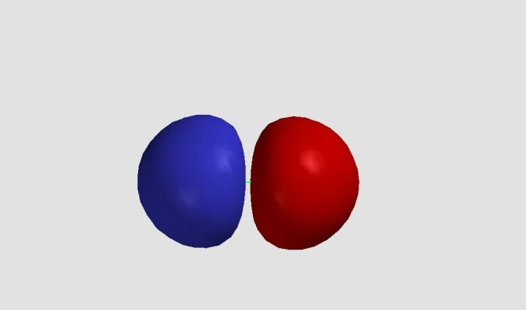
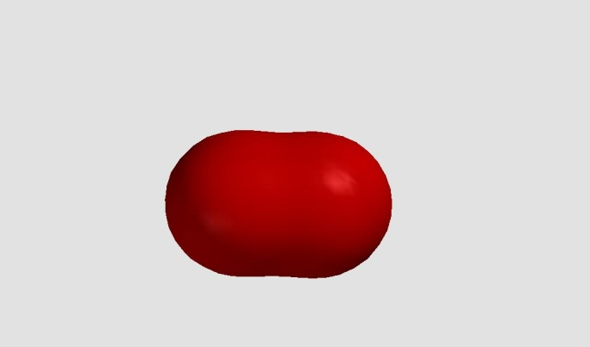
Valence Molecular Orbitals in F₂
The two lowest-energy molecular orbitals are similar to the orbitals of H₂.
The lowest is a sigma (σ*) bonding orbital, with a pair of delocalised electrons between the nuclei.
The second-lowest is a sigma-star (σ*)
anti-bonding orbital.
In F₂, the σ bonding
and σ* anti-bonding
orbitals both contain a
pair of electrons.
The sum of these is
no net bond.
(We’ll see where the bond comes from later.)
↑↓
↑↓
2p
↑↓
↑↓
↑
↑↓
↑↓
↑
↑↓
↑↓
↑↓
↑↓
σ∗
2s
↑↓
↑↓
↑↓
σ
Valence MOs

Slide 18


Three simple kinds of molecular orbitals
1. Sigma (bonding) orbitals (σ).
2. Non-bonding orbitals (n)
3. Sigma star (anti-bonding) orbitals (σ*)
Electrons delocalized along the axis between two nuclei. These may be represented as shared electrons, e.g. H:H or F-F
Orbitals that are essentially unchanged from atomic orbitals, and remain localized on a single atom (unshared).
These may be represented as a pair of electrons on one atom.
Orbitals with a node or nodes along the axis between two nuclei. These do not contribute to bonding, they “undo” or negate bonding.

Slide 19

Bonding of Multi-Electron Atoms
Before considering the other molecular orbitals of F₂, we will look at a simplier homonuclear diatomic molecules.
Bond order
$$\frac{bonding electrons −antibonding electrons}{2}$$

Slide 20
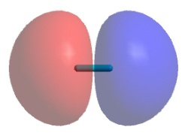
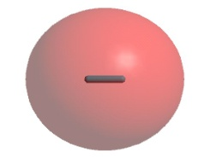
Diatomic molecules: The bonding in He₂
He also has only 1s AO, so the MO diagram for the molecule He₂ can be formed in an identical way, except that there are two electrons in the 1s AO on He.
The bond order in He₂ is (2-2)/2 = 0, so the molecule will not exist.
However the cation [He₂]⁺, in which one of the electrons in the σ_{u}* MO is removed, would have a bond order of (2-1)/2 = ½, so such a cation might be predicted to exist. The electron configuration for this cation can be written in the same way as we write those for atoms except with the MO labels replacing the AO labels:
[He₂]⁺ = σ_{g}²σ_{u}¹
He
He₂
He
σ_{u}*
Energy
1s
1s
σ_{g}
Molecular Orbital theory is powerful because it allows us to predict whether molecules should exist or not and it gives us a clear picture of the of the electronic structure of any hypothetical molecule that we can imagine.

Slide 21
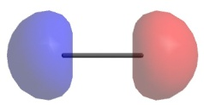
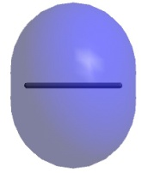


Diatomic molecules: Homonuclear Molecules of the Second Period
Li has both 1s and 2s AO’s, so the MO diagram for the molecule Li₂ can be formed in a similar way to the ones for H₂ and He₂. The 2s AO’s are not close enough in energy to interact with the 1s orbitals, so each set can be considered independently.
Li
Li₂
Li
2σ_{u}*
The bond order in Li₂ is (4-2)/2 = 1, so the molecule could exists. In fact, a bond energy of 105 kJ/mol has been measured for this molecule.
Notice that now the labels for the MO’s have numbers in front of them - this is to differentiate between the molecular orbitals that have the same symmetry.
2s
2s
2σ_{g}
Energy
1σ_{u}*
1s
1s
1σ_{g}

Slide 22
Diatomic molecules: Homonuclear Molecules of the Second Period
Be also has both 1s and 2s AO’s, so the MO’s for the MO diagram of Be₂ are identical to those of Li₂. As in the case of He₂, the electrons from Be fill all of the bonding and antibonding MO’s so the molecule will not exist.
Be
Be₂
Be
The bond order in Be₂ is (4-4)/2 = 0, so the molecule can not exist.
Note:
The shells below the valence shell will always contain an equal number of bonding and antibonding MO’s so you only have to consider the MO’s formed by the valence orbitals when you want to determine the bond order in a molecule!
2σ_{u}*
2s
2s
2σ_{g}
Energy
1σ_{u}*
1s
1s
1σ_{g}

Slide 23
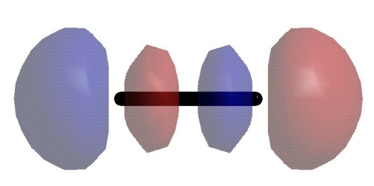
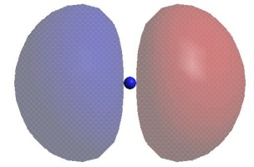
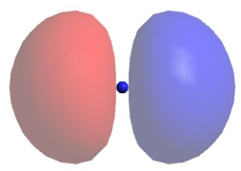
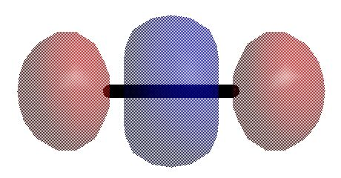
Back to F₂ - Diatomic molecules: The bonding in F₂
Each F atom has 2s and 2p valence orbitals, so to obtain MO’s for the F₂ molecule, we must make linear combinations of each appropriate set of orbitals. In addition to the combinations of ns AO’s that we’ve already seen, there are now combinations of np AO’s that must be considered. The allowed combinations can result in the formation of either σ or π type bonds.
The combinations of σ symmetry:
This produces an MO over the molecule with a node between the F atoms. This is thus an antibonding MO of σ_{u} symmetry.
+
2p_{zA}
2p_{zB}
σ_{u}* = √ 0.5 (2p_{zA} + 2p_{zB})
This produces an MO around both F atoms and has the same phase everywhere and is symmetrical about the F-F axis. This is thus a bonding MO of σ_{g} symmetry.
-
2p_{zA}
2p_{zB}
σ_{g} = √ 0.5 (2p_{zA} - 2p_{zB})

Slide 24
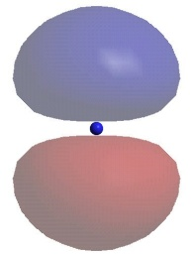
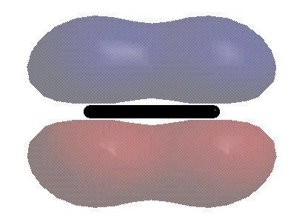
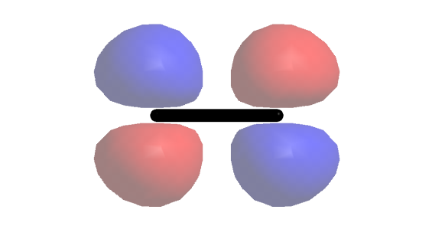
Diatomic molecules: The bonding in F₂
The first set of combinations of π symmetry:
This produces an MO over the molecule with a node on the bond between the F atoms. This is thus a bonding MO of π_{u} symmetry.
+
2p_{yA}
2p_{yB}
π_{u} = √ 0.5 (2p_{yA} + 2p_{yB})
This produces an MO around both F atoms that has two nodes: one on the bond axis and one perpendicular to the bond. This is thus an antibonding MO of π_{g} symmetry.
-
2p_{yA}
2p_{yB}
π_{g}* = √ 0.5 (2p_{yA} - 2p_{yB})

Slide 25
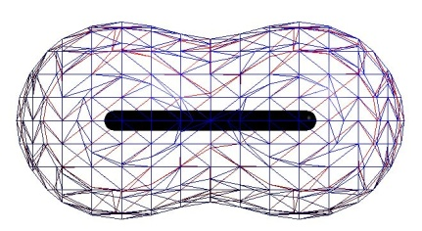
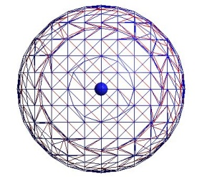
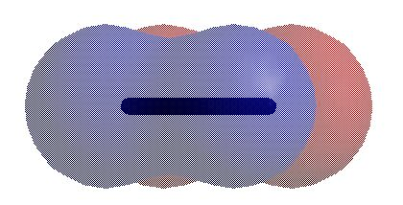
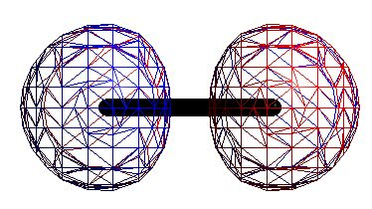
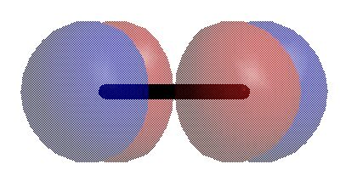
Diatomic molecules: The bonding in F₂
The second set of combinations with π symmetry (orthogonal to the first set):
This produces an MO over the molecule with a node on the bond between the F atoms. This is thus a bonding MO of π_{u} symmetry.
+
≡
2p_{xA}
2p_{xB}
π_{u} = √ 0.5 (2p_{xA} + 2p_{xB})
This produces an MO around both F atoms that has two nodes: one on the bond axis and one perpendicular to the bond. This is thus an antibonding MO of π_{g} symmetry.
-
≡
2p_{xA}
2p_{xB}
π_{g}* = √ 0.5 (2p_{xA} - 2p_{xB})

Slide 26
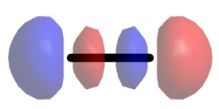
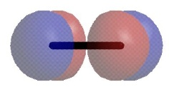
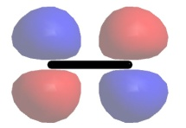
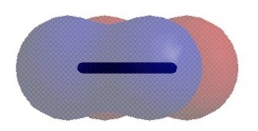
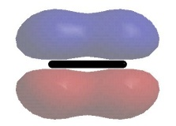
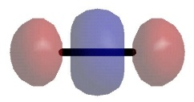
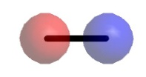
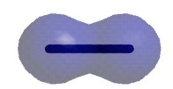
MO diagram for F₂
Molecular Orbital Theory
You will typically see the diagrams drawn in this way. The diagram is only showing the MO’s derived from the valence electrons because the pair of MO’s from the 1s orbitals are much lower in energy and can be ignored.
Although the atomic 2p orbitals are drawn like this: they are actually all the same energy and could be drawn like this:
at least for two non-interacting F atoms.
Notice that there is no mixing of AO’s of the same symmetry from a single F atom because there is a sufficient difference in energy between the 2s and 2p orbitals in F.
Also notice that the more nodes an orbital of a given symmetry has, the higher the energy.
Note: For simplicity, electrons are not shown in the atomic orbitals
F
F₂
F
3σ_{u}*
1π_{g}*
2p
(p_{x},p_{y})
p_{z}
2p
Energy
1π_{u}
3σ_{g}
2σ_{u}*
2s
2s
2σ_{g}

Slide 27
Molecular Orbital Theory
MO diagram for F₂
F
F₂
F
Another key feature of such diagrams is that the π-type MO’s formed by the combinations of the p_{x} and p_{y} orbitals make degenerate sets (i.e. they are identical in energy).
The highest occupied molecular orbitals (HOMOs) are the 1π_{g}* pair - these correspond to some of the “lone pair” orbitals in the molecule and this is where F₂ will react as an electron donor.
The lowest unoccupied molecular orbital (LUMO) is the 3σ_{u}* orbital - this is where F₂ will react as an electron acceptor.
LUMO
3σ_{u}*
HOMO
1π_{g}*
2p
(p_{x},p_{y})
p_{z}
2p
Energy
1π_{u}
3σ_{g}
2σ_{u}*
2s
2s
2σ_{g}

Slide 28
Molecular Orbital Theory
MO diagram for B₂
B
B₂
B
In the MO diagram for B₂, there several differences from that of F₂. Most importantly, the ordering of the orbitals is changed because of mixing between the 2s and 2p_{z} orbitals. From Quantum mechanics: the closer in energy a given set of orbitals of the same symmetry, the larger the amount of mixing that will happen between them. This mixing changes the energies of the MO’s that are produced.
The highest occupied molecular orbitals (HOMOs) are the 1π_{u} pair. Because the pair of orbitals is degenerate and there are only two electrons to fill, them, each MO is filled by only one electron - remember Hund’s rule. Sometimes orbitals that are only half-filled are called “singly-occupied molecular orbtials” (SOMOs). Since there are two unpaired electrons, B₂ is a paramagnetic (triplet) molecule.
3σ_{u}*
1π_{g}*
2p
(p_{x},p_{y})
p_{z}
2p
Energy
LUMO
3σ_{g}
HOMO
1π_{u}
2σ_{u}*
2s
2s
2σ_{g}

Slide 29
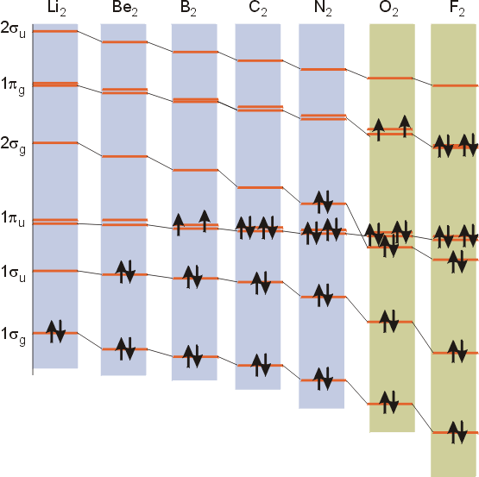
Diatomic molecules: MO diagrams for Li₂ to F₂
Remember that the separation between the ns and np orbitals increases with increasing atomic number. This means that as we go across the 2nd row of the periodic table, the amount of mixing decreases until there is no longer enough mixing to affect the ordering; this happens at O₂. At O₂ the ordering of the 3σ_{g} and the 1π_{u} MO’s changes.
As we go to increasing atomic number, the effective nuclear charge (and electronegativity) of the atoms increases. This is why the energies of the analogous orbitals decrease from Li₂ to F₂.
The trends in bond lengths and energies can be understood from the size of each atom, the bond order and by examining the orbitals that are filled.
2s-2p_{z} mixing
In this diagram, the labels are for the valence shell only - they ignore the 1s shell. They should really start at 2σ_{g} and 2σ_{u}*.
Molecule | Li₂ | Be₂ | B₂ | C₂ | N₂ | O₂ | F₂ | Ne₂
Bond Order | 1 | 0 | 1 | 2 | 3 | 2 | 1 | 0
Bond Length (Å) | 2.67 | n/a | 1.59 | 1.24 | 1.01 | 1.21 | 1.42 | n/a
Bond Energy (kJ/mol) | 105 | n/a | 289 | 609 | 941 | 494 | 155 | n/a
Diamagnetic (d)/ Paramagnetic (p) | d | n/a | p | d | d | p | d | n/a

Slide 30

Photoelectron Spectrum (PES) of O₂

Slide 31

Molecular Orbital Theory
MO diagram for O₂
O
O₂
O
LUMO
3σ_{u}*
HOMO
1π_{g}*
2p
(p_{x},p_{y})
p_{z}
2p
Energy
1π_{u}
3σ_{g}
2σ_{u}*
2s
2s
2σ_{g}

Slide 32

Photoelectron Spectrum of Carbon Monoxide

Slide 33
First…..A little about orbitals
Orbitals of the same symmetry overlap!!!
x
z
C-O
z
y
C∞
x
x
x
z
z
z
y
y
y
2 p_{x}
2 p_{y}
2 p_{z}

Slide 34
To the character tables!!!
2 p_{x}
2 p_{y}
2 p_{z}
2 s
C_{∞v}
 | E | 2C∞ | ∞ σ_{v} | linear, rotations | quadratic
A₁=Σ⁺ | 1 |  | 1 | z | x²+y², z²
A₂=Σ⁻ | 1 | 1 | -1 | R_{z}
E₁=Π | 2 | 2cos(Φ) | 0 | (x, y) (R_{x}, R_{y}) | (xz, yz)
E₂=Δ | 2 | 2cos(2φ) | 0 |  | (x²-y², xy)
E₃=Φ | 2 | 2cos(3φ) | 0
... | ... | ... | ...
C_{∞v} Point Group
not Abelian, ∞ irreducible representations

Slide 35
Molecular Orbital Theory of Carbon Monoxide
2 p
2 p_{z}
2 p
A₁
2 p_{z}
A₁
2 s
A₁
A₁
2s
C
CO
O

Slide 36
Molecular Orbital Theory of Carbon Monoxide
2 p
2 p_{z}
2 p
A₁
2 p_{z}
A₁
2 s
A₁
A₁
2s
C
CO
O

Slide 37
Molecular Orbital Theory of Carbon Monoxide
2 p
2 p_{x}
2 p_{y}
2 p
E₁
E₁
A₁
2 p_{x}
2 p_{y}
E₁
E₁
C
CO
O

Slide 38
Molecular Orbital Theory of Carbon Monoxide
2 p
2 p_{x}
2 p_{y}
2 p_{z}
2 p
2 p_{x}
2 p_{y}
2 p_{z}
2 s
2s
C
CO
O

Slide 39
Molecular Orbital Theory of Carbon Monoxide
2 p
2 p_{x}
2 p_{y}
2 p_{z}
2 p
2 p_{x}
2 p_{y}
2 p_{z}
2 s
2s
C
CO
O

Slide 40
Molecular Orbital Theory of Carbon Monoxide σ-only
2 p
2 p_{x}
2 p_{y}
2 p_{z}
2 p
2 p_{x}
2 p_{y}
2 p_{z}
2 s
2s
C
CO
O

Slide 41
WWSD?
What Would Spartan Do?
MO: 1 2 3 4 5
Eigenvalues: -1.47101 -0.76014 -0.59361 -0.59361 -0.47876
(ev): -40.02831 -20.68440 -16.15283 -16.15283 -13.02781
A1 A1 E1y E1x A1
1 C1 S 0.40617 -0.56410 0.00000 0.00000 -0.66059
2 C1 PX 0.00000 0.00000 -0.00230 0.51582 0.00000
3 C1 PY 0.00000 0.00000 -0.51582 -0.00230 0.00000
4 C1 PZ -0.33883 0.07726 0.00000 0.00000 -0.58792
5 O1 S 0.82117 0.48423 0.00000 0.00000 -0.03727
6 O1 PX 0.00000 0.00000 -0.00382 0.85669 0.00000
7 O1 PY 0.00000 0.00000 -0.85669 -0.00382 0.00000
8 O1 PZ 0.21426 -0.66433 0.00000 0.00000 0.46538
MO: 6 7 8
Eigenvalues: 0.03675 0.03675 0.22350
(ev): 0.99990 0.99990 6.08170
E1y E1x A1
1 C1 S 0.00000 0.00000 -0.28361
2 C1 PX 0.00040 0.85670 0.00000
3 C1 PY 0.85670 -0.00040 0.00000
4 C1 PZ 0.00000 0.00000 0.73046
5 O1 S 0.00000 0.00000 0.29969
6 O1 PX -0.00024 -0.51582 0.00000
7 O1 PY -0.51582 0.00024 0.00000
8 O1 PZ 0.00000 0.00000 0.54422

Slide 42





Photoelectron Spectrum of Carbon Monoxide and Molecular Orbital Theory
σ∗
A₁
π∗
E₁
σ∗
A₁
π
E₁
σ
A₁
σ
A₁
CO

Slide 43

Photoelectron Spectrum of Carbon Monoxide and Molecular Orbital Theory
σ∗
A₁
π∗
E₁
σ
A₁
π
E₁
σ∗
A₁
σ
A₁
CO

Slide 44


When acting as a ligand, does CO bind through the carbon or the oxygen?
C-O
HOMO orbital of CO

Slide 45
When acting as a ligand, does CO bind through the carbon or the oxygen?
1944 cm⁻¹ for ν CO in MbCO
Vs.
2143 cm⁻¹ for ν CO in free CO
Vs.
1760-1665 cm⁻¹ for ν carbonyl

Slide 46
Molecular Orbital Theory of CO²⁻
2 p
2 p_{x}
2 p_{y}
2 p_{z}
2 p
2 p_{x}
2 p_{y}
2 p_{z}
2 s
2s
C
CO
O

